Slide 1

Direction Sense
Placement Preparation
Aptitude & Reasoning
Prof. Krunal D. Vyas
Computer Engineering Department
krunal.vyas@darshan.ac.in
9601901005

Slide 2
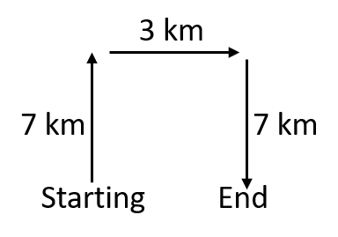
Examples
Example-1: Shyam travels 7 km North, then he turns to his right and walks 3 km. He again turns to his right and moves 7 km forward. Now in which direction is he from his starting point?
Solution-1:
At the end he is East direction from his starting point.

Slide 3
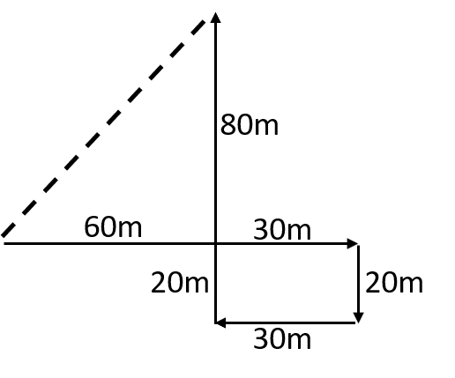
Examples
Example-2: A child is looking for his father. He went 90 meters in the east before turning to his right. He went 20 meters before turning to his right again to look for his father at his uncle’s place 30 meters from this point. His father was not there. From there he went 100 meters to his north before meeting his father in a street. Now how far he is from his starting point?
Solution-2:
Required distance = $\sqrt{{80}^{2}+{60}^{2}}$ = $\sqrt{6400+3600}$ = 100 m

Slide 4
Examples
Example-3: A man is facing North. He turns to 180 ̊ in clockwise direction and another 45 ̊ in the same direction and then 270 ̊ in the anticlockwise direction. In which direction is he facing now?
Solution-3: Let’s take clockwise angle as + and anticlockwise angle as –
• 180 ̊ + 45 ̊ - 270 ̊ = - 45 ̊
• Now, - 45 ̊ from North direction will be North-West direction.

Slide 5
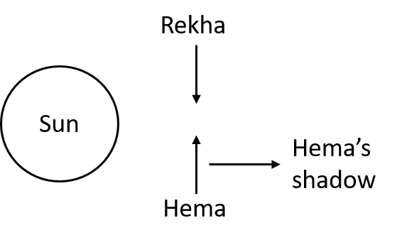
Examples
Example-4: In an evening Rekha and Hema were talking to each other face to face. If Hema’s shadow was exactly to the right of Hema, which direction was Rekha facing?
Solution-4: In an evening, Sun is in West side.
So, Rekha was facing South direction.

Slide 6
Exercise
Ex-1: Rohit start travelling 20 m toward North. Then he takes a right turn and goes 30m then he takes a right turn again and goes 45m. Then he takes a left turn and goes 20m. Finally, he takes a left turn and goes 15m. In which direction is he from the starting point?
Ex-2: Mr. Kamal goes 17 km in East then he takes a right turn and goes 52 km, then he takes a left turn and goes 7 km, again he takes a left turn and goes 21 km. Finally, he takes a left turn and goes 24 km. how far and in which direction is he from the starting point?
Ex-3: One morning Amit and Sumit were talking to each other face to face. Amit’s shadow was exactly to the right of Sumit. In which direction Sumit was facing?
Ans = South-East
Ans = 31KM South
Ans = South

